Slide 2
Digital Forensics Lecture-16
By- Dr.subhranil Das
Assistant Professor
School of computer Science

Slide 3

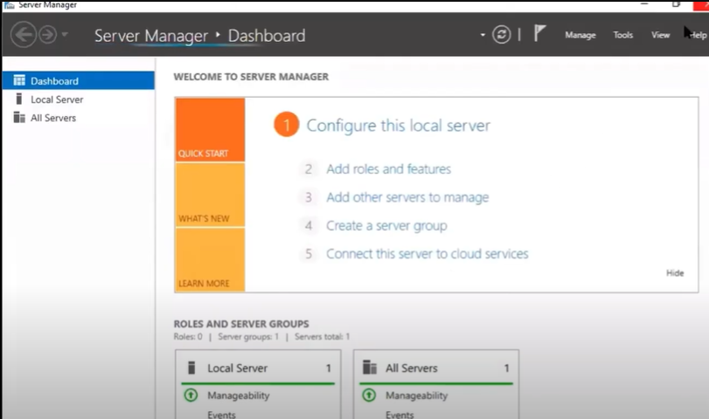
Server Manager

Slide 4
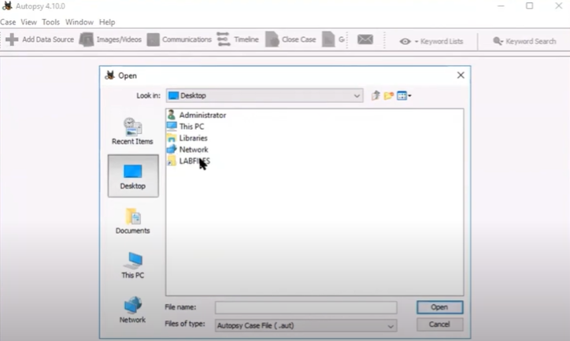
Search the contents

Slide 5
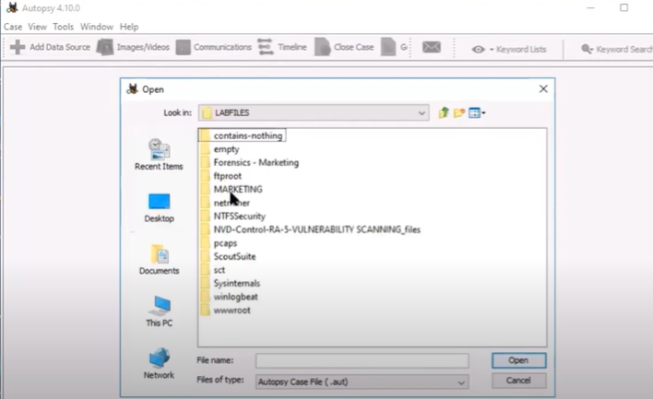
Search the contents

Slide 6
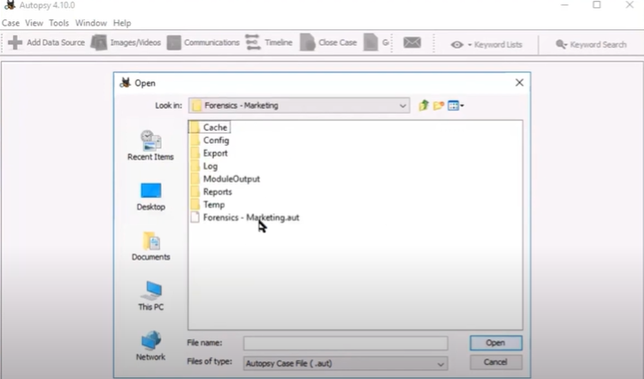
Click on Forensics Marketing.aut

Slide 7
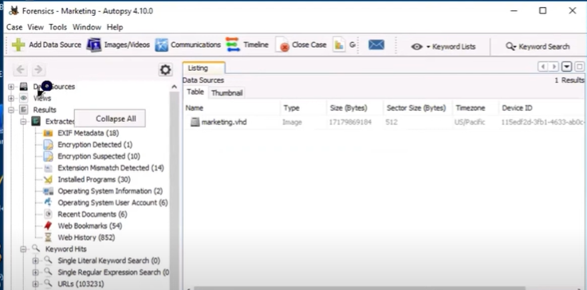
Opening the Case file

Slide 8
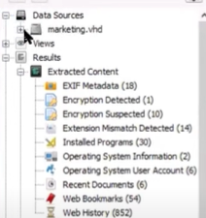
Expand the data sources

Slide 9
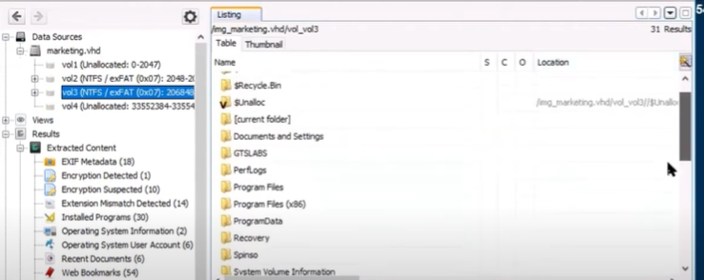
Click on Vol3

Slide 10
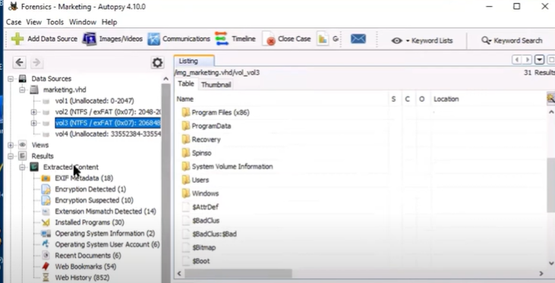
Click on Vol3

Slide 11
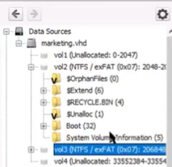
Click on Vol.2

Slide 12
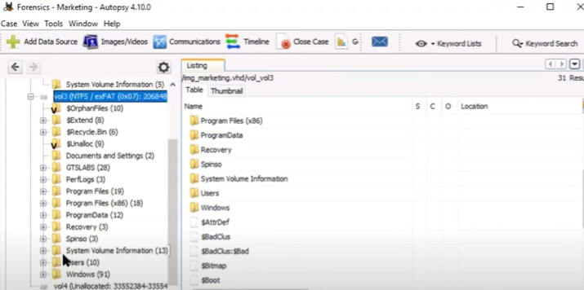
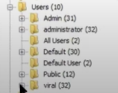
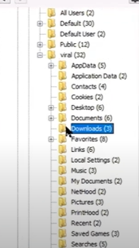
Processing the Downloads folder

Slide 13


Downloads folder

Slide 14
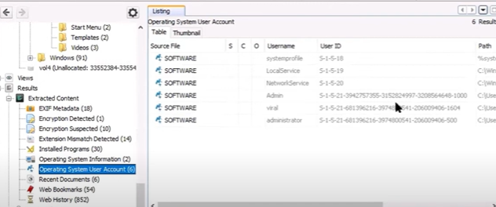
Go to the folder of extracted content

Slide 15
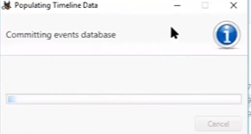
Analyzing the Timeline data

Slide 16
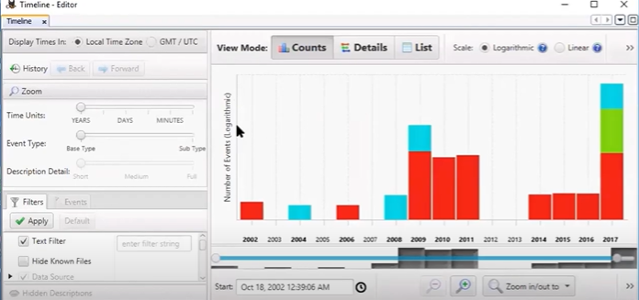
Overview of the Timeline DATA

Slide 17
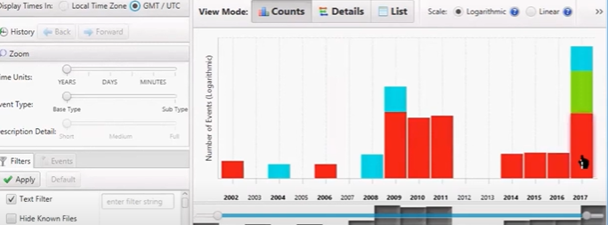
Select GMT

Slide 18
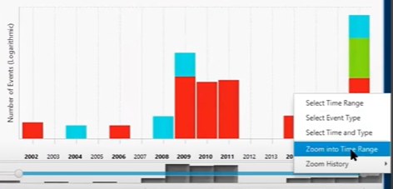
Select the Long Bar

Slide 19
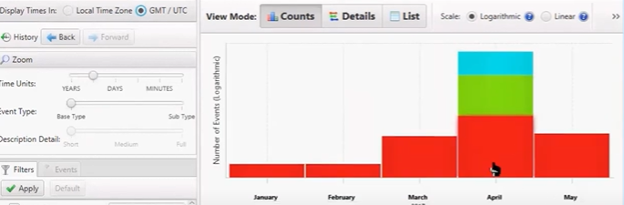
Expanding the Time column

Slide 20
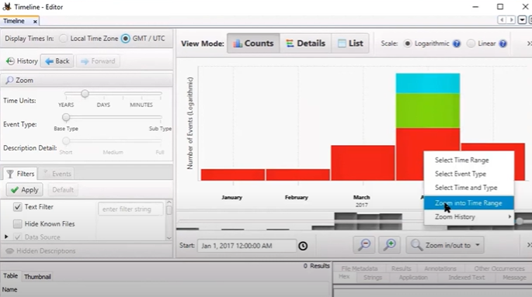
Click the month

Slide 21
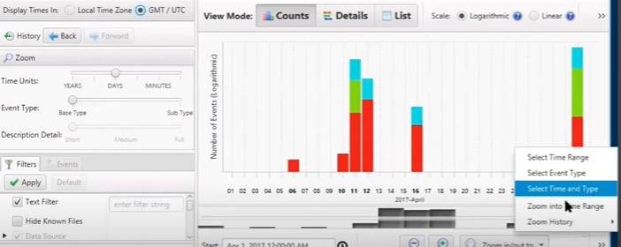
Click on the Day

Slide 22
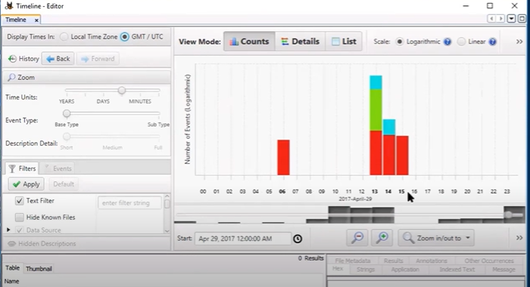
Click on the Time range

Slide 23
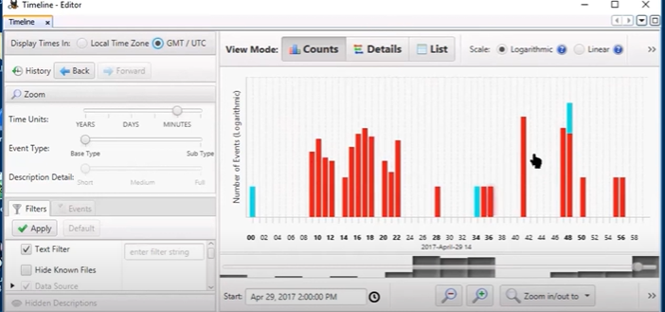
Select the hour range

Slide 24
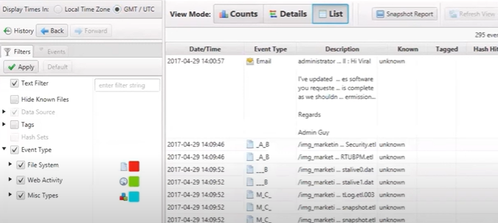
Go to the list view

Slide 25
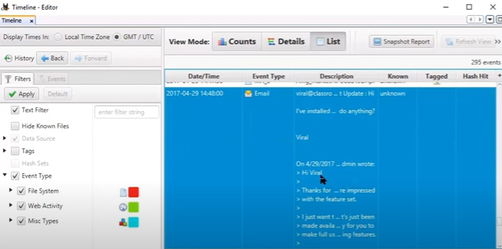
Edit the mail

Slide 26
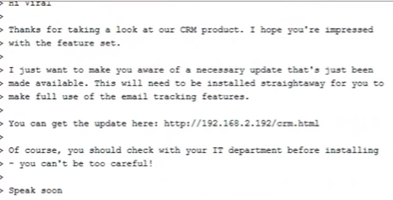
Overview of mail

Slide 27
Assignment Question-2 (Last Date-04/10/24)
1. Discuss the unique challenges that cloud forensics faces in comparison to traditional digital forensics. Include in your answer how multi-tenancy, data location, and volatile data contribute to these challenges. How do current forensic tools address these challenges, and what are the limitations of these tools?
2. Explain the importance of the chain of custody in digital forensics. Describe the steps involved in ensuring the integrity and admissibility of digital evidence in court. Discuss how the chain of custody can be maintained when collecting digital evidence from cloud environments, considering issues such as data integrity and legal compliance.
3. Compare and contrast the different techniques for acquiring digital evidence from various sources such as computers, mobile devices, and cloud environments. Discuss the advantages and disadvantages of using tools like Linux Boot CDs, ProDiscover, and Access Data FTK Imager for image acquisition. How does the method of acquisition affect the subsequent analysis and preservation of digital evidence?

Slide 28
Assignment uploading
1. All the assignments should be hand written.
2. If your ID NO- 40004294 and Name- Subhranil Das, rename the file as “40004294 _ASSIGN1” in the Folder as created by CR.
3. For CR, create a folder as Computer Graphics as “B3_Computer Graphics_ASSGN1”
(Last Date-15/09/24)

Slide 29
Next Class
QUIZ-2

